Slide 1


KL Deemed to be University
Aziz Nagar Campus
Department of ECE
Design and Evaluation of a Configurable AI Acceleration Extension for an Embedded RISC-V Processor on FPGA
2nd Review
MD Sameer Ahmed - 2310040004
Sayooj S - 2310040095
Supervised by:
Dr. B Anil Kumar, Assoc. Prof./ECE

Slide 2
Introduction :
Edge AI applications require efficient processors for fast, low-power computation on embedded devices.
RISC-V enables customizable processor architectures through flexible instruction set extensions and open-source designs.
This project develops a configurable FPGA-based AI accelerator integrated with a PicoRV32 RISC-V processor.

Slide 3
Problem Statement :
Embedded RISC-V processors execute AI workloads with high latency and limited computational efficiency.
Software execution of matrix operations increases execution cycles, power consumption, and processing time.
Configurable hardware acceleration is required for efficient AI processing in embedded systems.

Slide 4
Objectives :
Design a configurable MAC-based AI accelerator integrated with the PicoRV32 RISC-V processor.
Implement custom instructions including MATMUL, CONV, MAC, DOT, LOAD_TILE, STORE_TILE and WAIT.
Evaluate performance, area, clock frequency and power across 2/4/8-MAC configurations and different operand widths.

Slide 5
Scope of the Project :
Implement PicoRV32 and the configurable accelerator on the Digilent Basys 3 FPGA with Xilinx Artix-7 XC7A35T.
Develop the accelerator using SystemVerilog, with a MAC array, scratchpad, controller/FSM and register interface.
Verify the design using SystemVerilog/Cocotb and evaluate AI kernels such as matrix multiplication, Sobel, Gaussian blur, FIR, dot product and tiny CNN.

Slide 6
Literature Review :
RedMulE demonstrates compact FP16 matrix-multiplication acceleration for RISC-V-based systems.
SCAIE-V provides a scalable interface for integrating custom hardware extensions into RISC-V processors.
CIDRE and related studies demonstrate the performance benefits of custom instructions, while leaving a gap in systematic configurable FPGA evaluation.
Research Gap :
Existing studies generally focus on individual accelerators, interfaces or workloads; this project evaluates MAC count, operand width and benchmark workload together on FPGA.

Slide 7
Methodology :
Problem & Requirement Analysis: Identify scalar execution limitations and define hardware/software requirements.
System Design & Implementation: Integrate PicoRV32 with the custom-instruction interface, configurable MAC array, scratchpad and controller.
Verification & Evaluation: Perform unit, differential, randomized and regression testing, followed by FPGA implementation and performance measurement

Slide 8
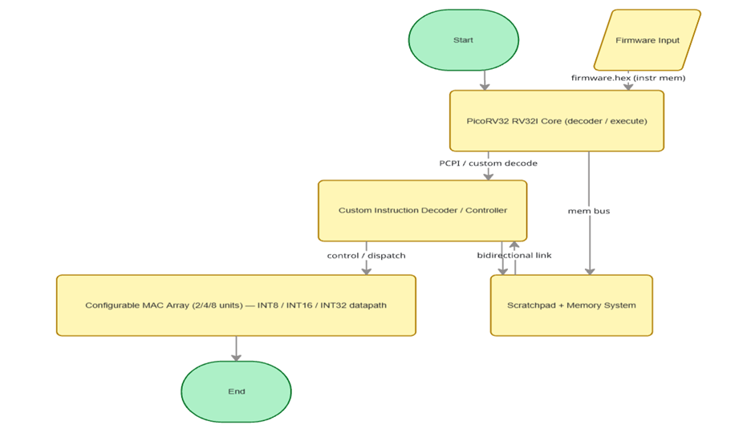
FLOW CHART
Proposed architecture — configurable AI acceleration extension for an embedded RISC-V processor on FPGA.

Slide 9
Expected Outcomes :
Develop a functional configurable AI accelerator with verified custom instructions and benchmark programs.
Generate FPGA implementations for 2/4/8-MAC configurations with timing, area and power reports.
Demonstrate an expected 5–20× speedup for benchmark kernels with the 8-MAC configuration and analyze speedup–area–power trade-offs.

Slide 10
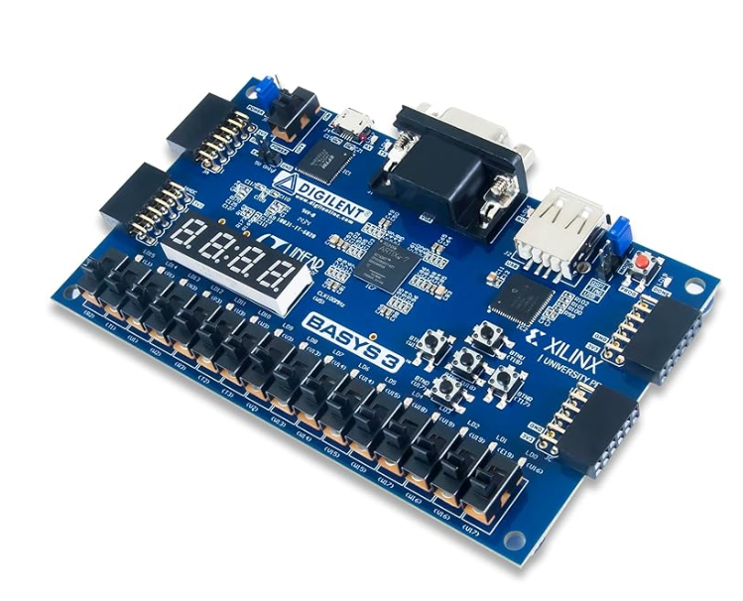
Financial Arrangements :
SL.NO | ITEM | DESCRIPTION | COST
1 | FPGA Development Board | Digilent Basys 3 – Xilinx Artix-7 XC7A35T | ₹18,000
2 | Programming & Connection Accessories | USB cable, power adapter, jumper wires, breadboard | ₹2,500
3 | Electronic Components | LEDs, resistors, switches, basic prototyping hardware | ₹1,200
4 | Documentation & Printing | Reports, charts and supporting documents | ₹800
 | Grand Total |  | ₹22,500

Slide 11

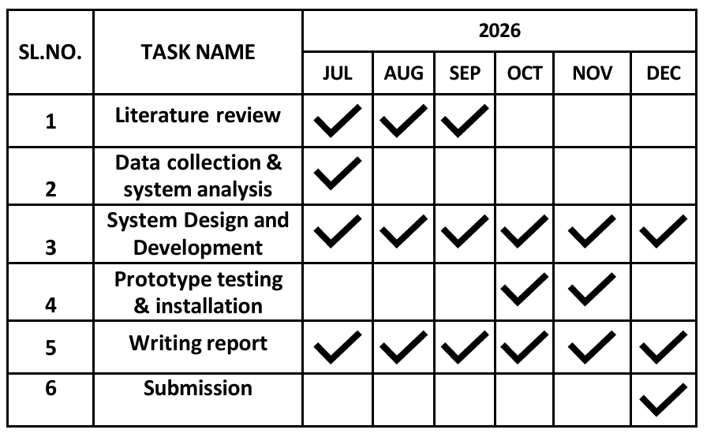
Duration :
Expected time line schedule

Slide 12
RESEARCH GAP
Paper | Research focus | Key contribution | Limitation
RedMulE | Matrix multiplication acceleration on RISC-V | Shows a compact, configurable FP16 accelerator for better speed and energy efficiency | Mainly focused on matrix multiply, not full FPGA trade-off study
SCAIE-V | Custom ISA interface for RISC-V | Provides a scalable interface for adding hardware extensions | It is an interface design, not a complete AI accelerator
Analog AI Hardware Review | Analog AI hardware for neural networks | Reviews energy-efficient analog AI hardware trends | It is only a review, no implementation or FPGA results
CIDRE | Custom instruction design for RISC-V | Shows that custom instructions can improve performance with small area cost | It does not directly study a configurable FPGA accelerator

Slide 13
References :
[1] Y. Tortorella, L. Bertaccini, D. Rossi, L. Benini, and F. Conti, “RedMulE: A compact FP16 matrix-multiplication accelerator for adaptive deep learning on RISC-V-based ultra-low-power SoCs,” in Proc. IEEE/ACM Int. Symp. Low Power Electronics and Design (ISLPED), Boston, MA, USA, 2022, pp. 1–6.
[2] M. Damian, J. Oppermann, C. Spang, and A. Koch, “SCAIE-V: An open-source scalable interface for ISA extensions for RISC-V processors,” in Proc. 59th ACM/IEEE Design Automation Conf. (DAC), San Francisco, CA, USA, 2022, pp. 1–6. doi: 10.1145/3489517.3530432.
[3] K. S. Gorde, S. M. Sonavane, S. Hutke, and A. Hutke, “Analog artificial intelligence hardware for neural networks: Design trends and considerations,” Bull. Electr. Eng. Inform., vol. 14, no. 6, pp. 4399–4410, Dec. 2025. doi: 10.11591/eei.v14i6.10842.
[4] E. Rezunov, N. Zurstraßen, L. M. Reimann, and R. Leupers, “Automatic microarchitecture-aware custom instruction design for RISC-V processors,” in Proc. IEEE/ACM Int. Conf. Computer-Aided Design (ICCAD), Munich, Germany, 2025, pp. 1–9. doi: 10.1109/ICCAD66269.2025.11240781.
[5] P. Warden and D. Situnayake, TinyML: Machine Learning with TensorFlow Lite on Arduino and Ultra-Low-Power Microcontrollers. Sebastopol, CA, USA: O’Reilly Media, 2021.
[6] A. Waterman and K. Asanović, The RISC-V Instruction Set Manual. Berkeley, CA, USA: CS Division, Univ. California, 2017.
[7] Xilinx, Inc., 7 Series FPGAs Data Sheet: Overview. San Jose, CA, USA, 2023.
[8] Digilent, Inc., Basys 3 Artix-7 FPGA Trainer Board Reference Manual. Pullman, WA, USA, 2020.

